Slide 1
Visualizing Model Behavior
Julius Adebayo & Hima Lakkaraju

Slide 2
Agenda
Upcoming Deadline
October 22nd – HW2
Paper 1: Visualizing Deep Neural Network Decisions
[Hima Lakkaraju]
Short Break [10 minutes]
Paper 2: Sanity Checks for Saliency Maps
[Julius Adebayo]
Mid-term Project Presentations

Slide 3
Visualizing Deep Neural Network Decisions
Luisa Zintgraf, Taco Cohen, Tameem Adel, Max Welling

Slide 4
Contributions
Presents (improvements of) prediction difference analysis method
Visualizing the response of a DNN to a specific input
Probabilistically sound methodology
Provides insight into decision making of classifiers
Experiments on ImageNet and MRI scans

Slide 5
Motivation
Deep Neural Nets (DNNs) widely used for
Speech recognition
Image classification
DNN → complex non-linear function
Lack of transparency → a huge problem
Self driving, medicine, criminal justice

Slide 6
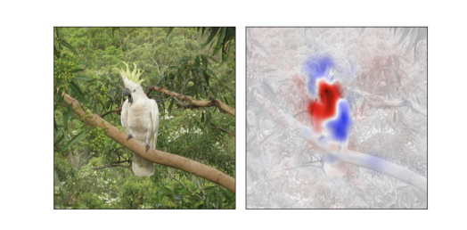
Overview
A novel, probabilistically sound methodology for explaining decisions of DNNs
Produces saliency maps such as
Red is for, blue is against the prediction

Slide 7
Prior Work
Two approaches for visual investigation of DNNs:
Find an input that maximally activates a given unit or class score to visualize what network is looking for
Visualize how network responds to a specific input image to explain a particular classification made by network
Instance specific method [current paper]

Slide 8
Prior Work: Instance Specific Methods
Class saliency visualization [Simonyan et. al. 2013]
How sensitive is classification score to small changes in pixel values?
Partial derivative of class score w.r.t. input features
DeepLIFT [shrikumar et. al. 2016]
Compare activation of a unit to a reference activation of the unit (when a specific input is fed forward)

Slide 9
Prior Work: Medical Image Classification
Plot weights of a linear classifier [kloppel et. al. 2008]
Independent of input image
But, interpreting these weights can be misleading
Why?

Slide 10
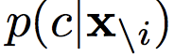
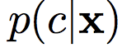
Prior Work: Prediction Difference Analysis
Robnik-Šikonja & Kononenko (2008)
For a given prediction, assign a relevance score to each input feature w.r.t. a class c
Intuition: the relevance of a feature x_{i} can be estimated by measuring how prediction changes if the feature is unknown
Difference between and

Slide 11
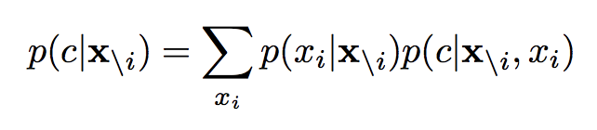
Evaluating Prediction When Feature is Unknown
Label the feature as unknown
Only few classifiers allow
Retrain classifier with the feature left out
Infeasible with DNNs and high dimensional data
Simulate the absence of a feature by marginalizing it

Slide 12
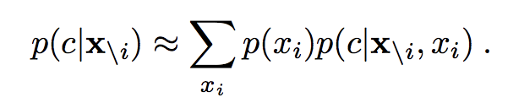
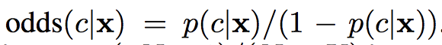
Prediction Difference Analysis
Prior probability can be approximated by empirical distribution of that feature
Comparing the probabilities using weight of evidence

Slide 13
Prediction Difference Analysis
WE reflects relative importance of all features (for a prediction)
Large prediction difference → feature contributed substantially to classification
Small difference → feature was not important
Positive value → evidence for
Negative value → evidence against

Slide 14
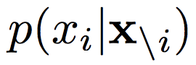
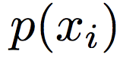

This Work: Conditional Sampling
Approximating conditional probability using marginal distribution is very crude
New intuition:
a pixel depends most strongly on a small neighborhood around it
the conditional of a pixel given its neighborhood does not depend on the position of the pixel in the image

Slide 15
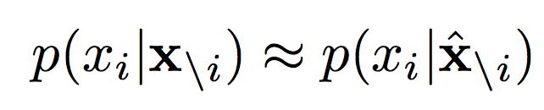
This Work: Conditional Sampling
New approximation:
Improved approximation/Tractable
For a feature to be relevant:
Relevant to predict class of interest
Should be hard to predict from neighboring pixels

Slide 16
This Work: Multivariate Analysis
Previous work: only one feature removed at a time (univariate)
Issues?
Multivariate: remove several features at once
remove patches of connected pixels

Slide 17
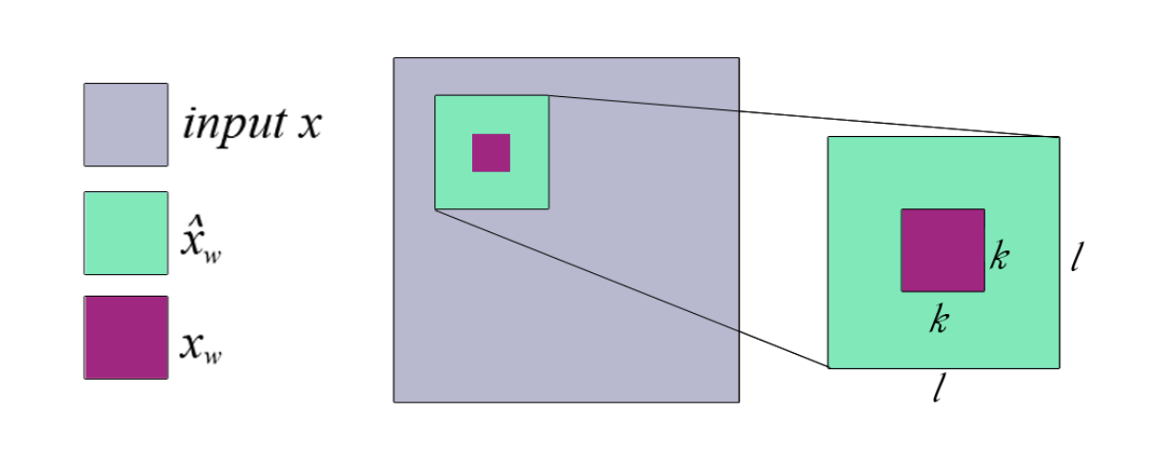
This Work: Multivariate Analysis
Think of this outer patch as neighborhood
Think of this small patch as a feature

Slide 18
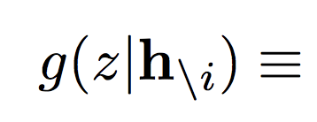
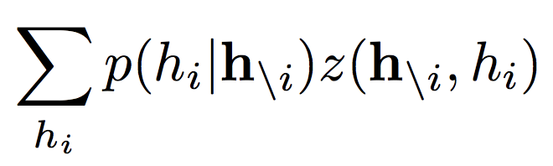
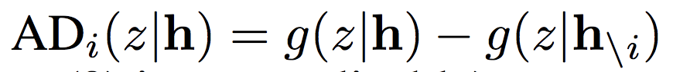
This Work: Deep Visualization of Hidden Layers
Also interesting to understand what goes on within hidden layers
Activation difference:
Value of node in
subsequent layer
Value in layer H of network

Slide 19
Experimental Evaluation
Two datasets:
ImageNet
MRI Scans
Comparing Marginal vs Conditional Sampling
Studying Multivariate Analysis
Studying Deep Visualization of Hidden Layers

Slide 20
ImageNet
Images from Russakovsky et. al. and three DNNs
AlexNet
GoogLeNet
VGG
Publicly available pre-trained models
Analyzing one image: 20, 30 and 70 minutes

Slide 21
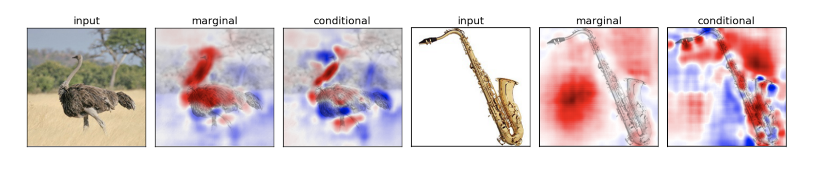
Marginal vs Conditional Sampling
Marginal Sampling → pixels that can be easily predicted using neighborhood are important
Conditional Sampling → more specific and fine grained results

Slide 22
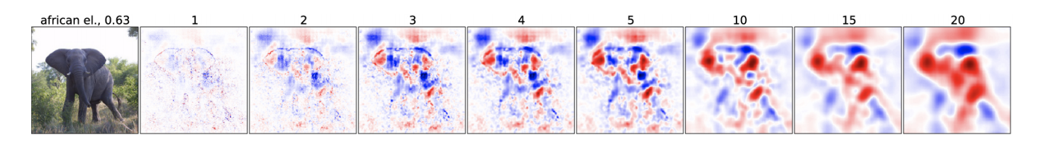
Multivariate Analysis : Window Sizes
AlexNet, l = k + 4, varying k
Increasing window size → more easily interpretable, smooth until image gets blurry

Slide 23
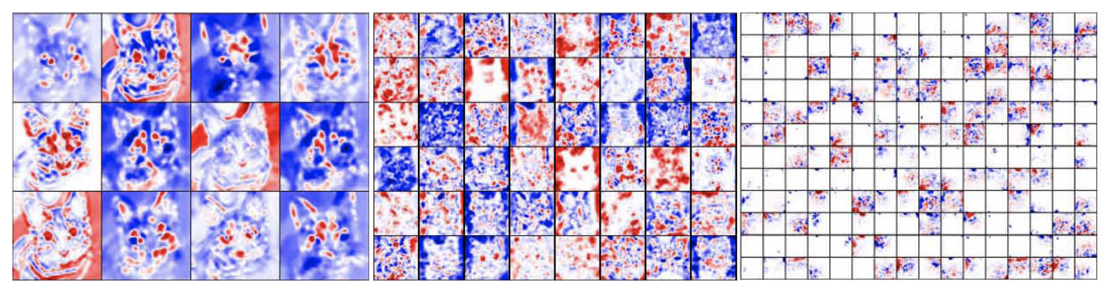
Visualization of Hidden Layers
Three different layers of GoogLeNet
How different feature maps in 3 different layers react to tabby cat image?
K = 10, l = 14

Slide 24
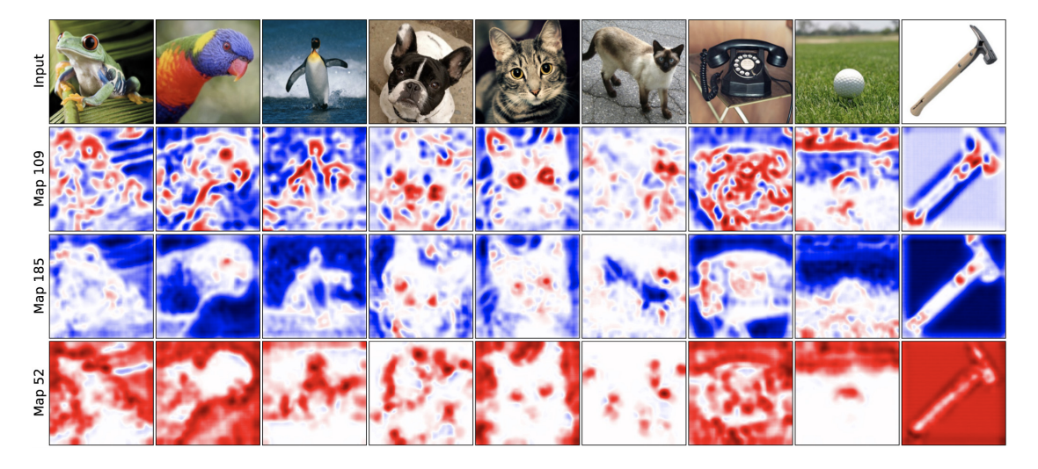
Visualization of Hidden Layers
Visualize 3 different feature maps react to multiple images
Middle of the network -- GoogLeNet

Slide 25
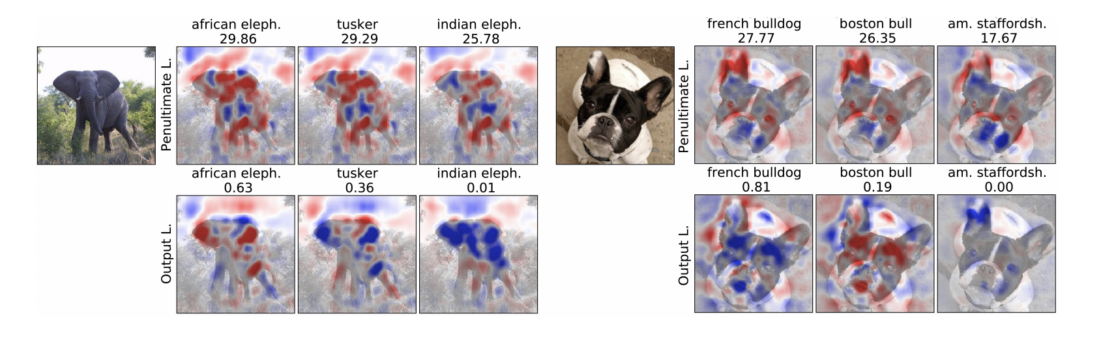
Penultimate vs Output Layers
Visualizations in penultimate layer look similar if classes are similar
In the final layer, values of nodes are all interdependent

Slide 26
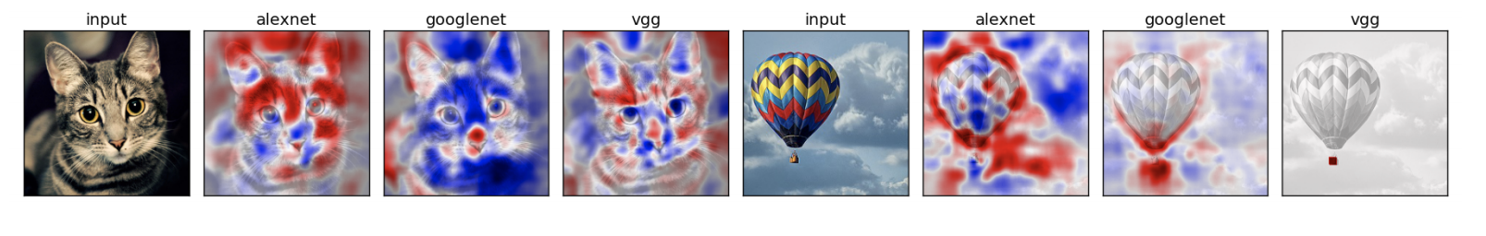
Comparing Neural Architectures
AlexNet is looking at more contextual info
E.g., sky in balloon image
VGG: last image
Basket differentiates between balloon and parachute

Slide 27
MRI Data
MRI Data of HIV and Healthy patients
COBRA dataset:
100 HIV patients
70 healthy patients
3D MRIs
91 × 109 × 91 = 902, 629 voxels

Slide 28
Experimental Setting
L2 regularized logistic regression
Balanced dataset
69.3% accuracy
10 fold cross validation
Analyzing one image – 30 minutes

Slide 29
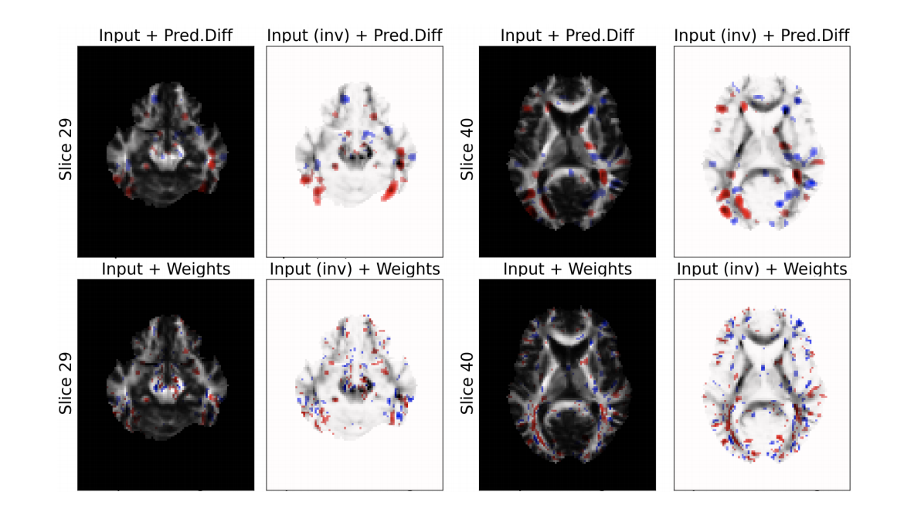
Prediction Difference vs. Weights

Slide 30
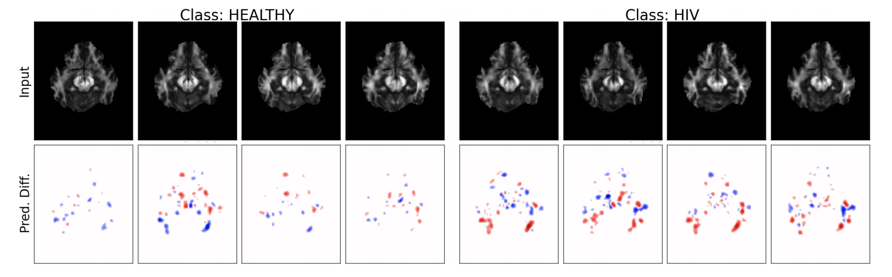
Visualizations for Different Classes

Slide 31
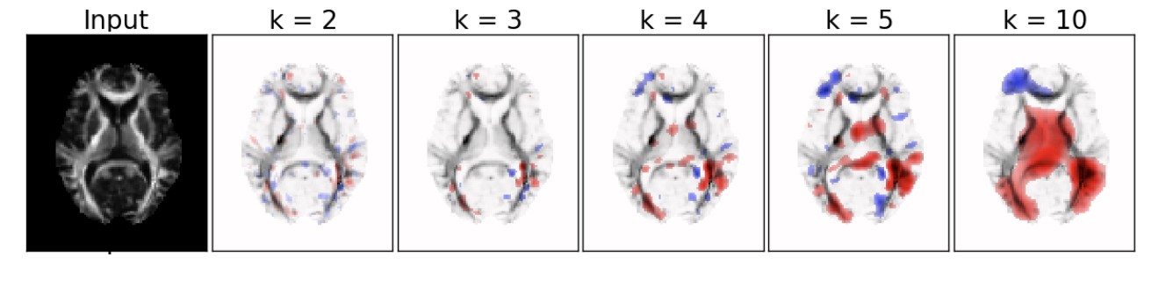
Influence of Patch Size

